Slide 1


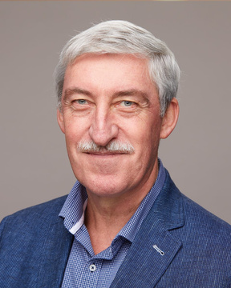
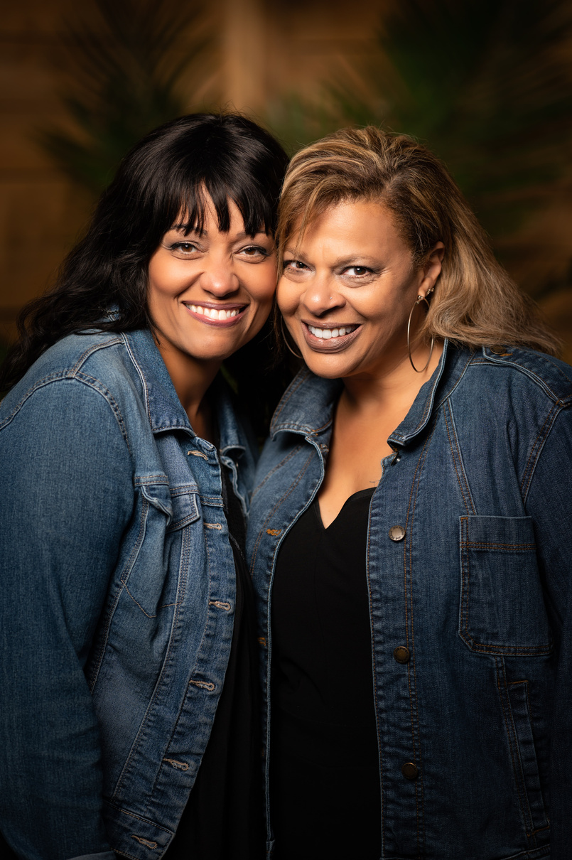

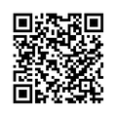
AUTUMN GETAWAY
COMING SEPTEMBER 18-22, 2023
Autumn Getaway exists to challenge men and women to continue living deeply in relationship with God, bless their own home communities, and build a strong legacy of faith. No matter what stage of life you find yourself in, you can find the opportunity to experience the overwhelming beauty and quiet splendour of autumn at MBC. Join us this September for a full five days to relax, refresh and renew your spirit.
TEACHER
MUSIC
Lawson Murray
Marlene O'Neill & Cathy Borges
FIND OUT MORE
www.muskokabible.com

